Slide 1










SATHYABAMA
INSTITUTE OF SCIENCE AND TECHNOLOGY
(DEEMED TO BE UNIVERSITY)
CATEGORY-1 UNIVERSITY BY UGC
Accredited with "A++" Grade by NAAC | Approved by AICTE
BUDGET PADMANABHAN
College Name: PANIMALAR ENGINEERING COLLEGE CHENNAI CITY CAMPUS
Team Number: HAE070
Team Name: CODE WARNING
Team Members: MA MOHAMED SIDDIQH, SABARINATHAN P, NAVNEEDAN M, MANOHAR M, HEMNATH M
HACKERA

Slide 2
Budget Padmanabhan
Lack of financial awareness of saving among people.
After boom of UPI payments we don’t have hesitation to spend.
Many are unable to differentiate between savings & investment.
Teens who have motive to save money don’t know the way.
HACKERA

Slide 3
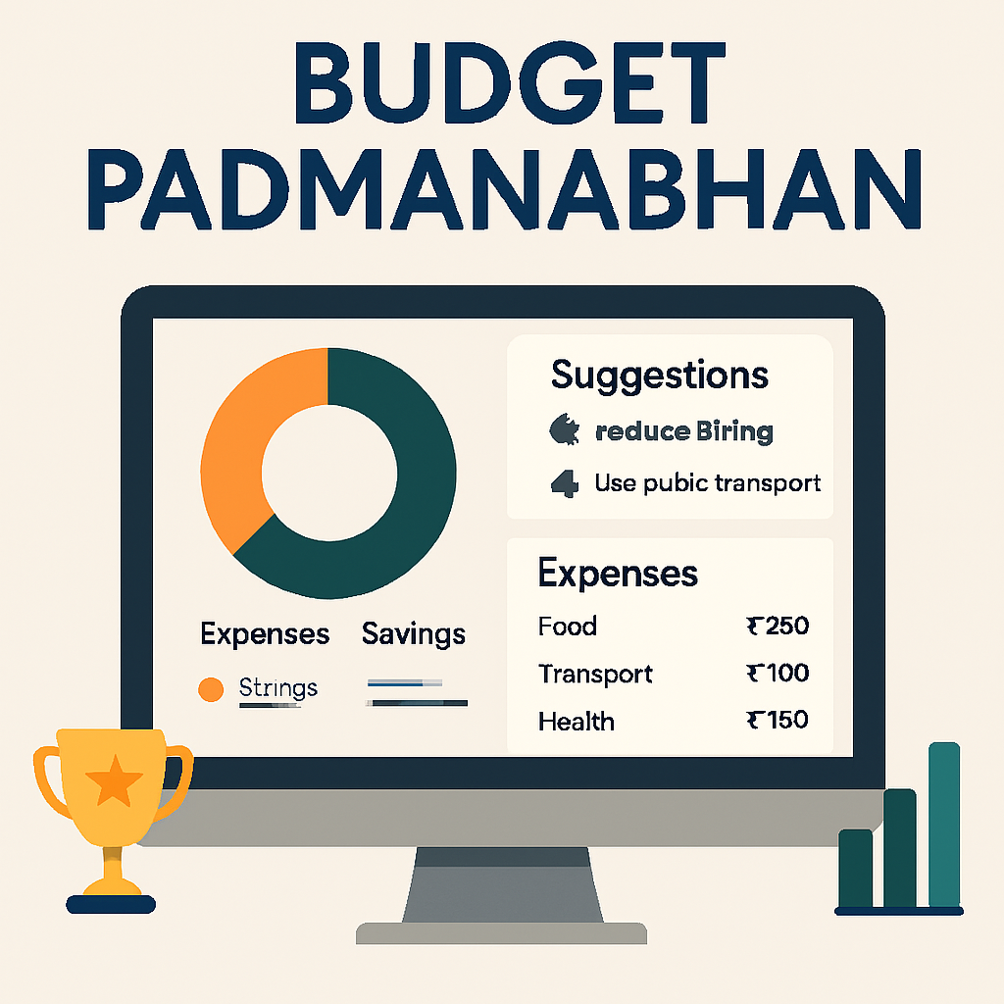
Solution Overview
Easy-to-use tool with suggestions from AI, and auto expense logging .
Our app offers predictive expense analysis, saving analysis and investment tips .
Restricts on overspending.
Have buffer (savings) for emergency purposes.
HACKERA

Slide 4
Innovation and Uniqueness
UPI app itself gives the suggestion and budget planning.
Every transaction is logged as spent data immediately.
Saving analysis, expenses analysis, investment suggestion are given using advance LLM.
Age-group-specific experiences (Teen/Adult/Senior UI modes).
HACKERA

Slide 5






Implementation
Tech Stack:
Backend: Python, Nodejs
Frontend: Tailwind CSS, React, Typescript
Database: Mongo DB
ML Algorithms: Random Forest, Isolation Forest, Time Series Forecasting, LLMs
HACKERA

Slide 6
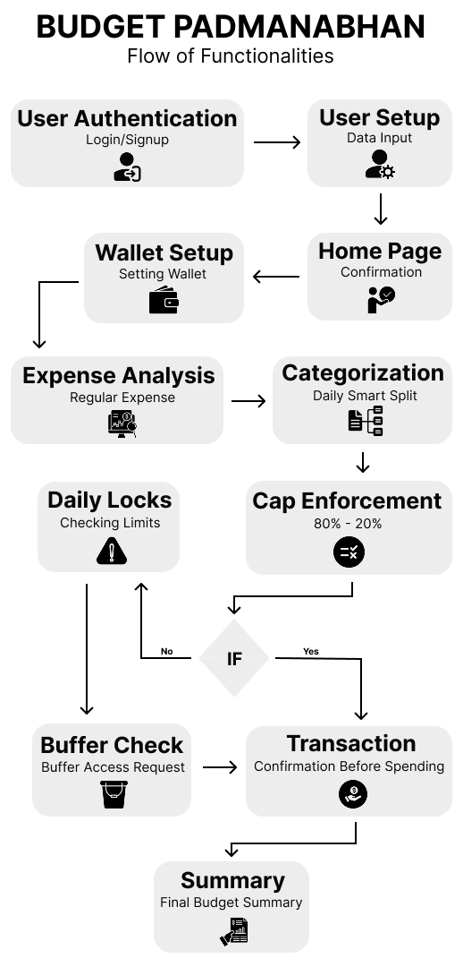
Strategy
Flow: User Signup/Profile → Expenses Log (Form/automatic) → alert on over spent → buffer(use on emergency) → LLM analysis on optimization → suggestion on investment
HACKERA

Slide 7
Impact and Feasibility
Promotes financial discipline in users.
Accessible via mobile-friendly design like a UPI app.
Light weight & Deployable web.
As digital payments are booming it is easily feasible.
Conclusion
Our app helps the users managing their daily expenses effectively with AI .
Challenges: daily login , following suggestion.
Future: contributing in cibil score, ensuring more ecofriendly transactions(carbon footprint tracer).
HACKERA

Slide 8

HACKERA’25
National-Level
24-HOURS
Hackathon
THANK YOU

